Slide 1
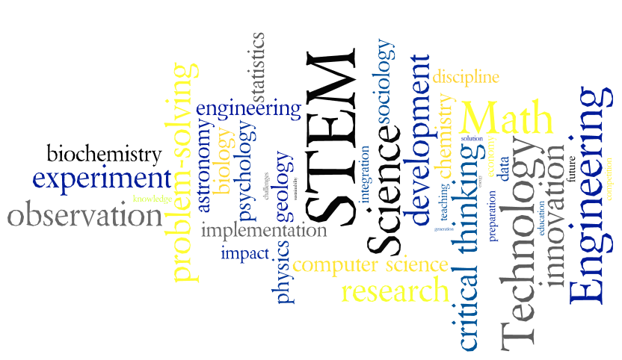
College Readiness in Science

Slide 2
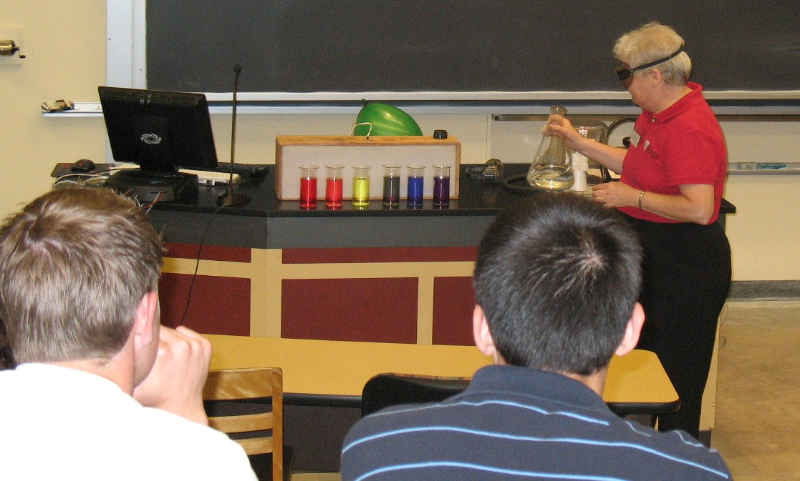
What courses should students take?
4 years of English
4 years of Science
Physics
Chemistry with lab
4+ years of Math
Algebra I and II
Geometry
Trigonometry
Calculus for math, engineering or physical science majors
Statistics for biology or behavioral/ social sciences majors
Notes:
The students that I see coming to college with gaps in their high school science education:
never had any physics – their high school didn’t offer it
never had any sort of lab
Also see students with gross deficiencies in math, esp. algebra.
Biologists will take 1-2 yrs chemistry and lots of biology. Chemists will take 1 yr physics and lots of chemistry. Physic majors take 1 year chemistry and physics. Pre-meds need a little bit of everything.

Slide 3
Do AP courses matter?
Anything a high school student can do to get a head start on college coursework will benefit.
Earning college credit in high school can allow students to:
Take a lighter load in college
Save money on tuition and possibly work less
Graduate early and enter the workforce sooner
Even if college credit is not earned, having had the course previously boosts confidence and sets students up for success in college.
Notes:
Taking a lighter load and/or working less can result in better grades, which can result in scholarships, work less, focus on school more…

Slide 4
Are AP courses the only way to earn college credit prior to enrolling?
Other options besides AP:
CLEP exams
DSST: DANTES Subject Standardized Tests
Test-outs given by the college
College in schools
International Baccalaureate
Postsecondary enrollment option
Notes:
CLEP offers 33 exams in five subject areas
DSST: Recommended for credit by the American Council on Education (ACE), the38 subject-level exams are offered in diverse disciplines and cover upper and lower-level baccalaureate credit courses. Thousands of colleges and universities recognize and recommend DSST exams for credit to students of all kind, from adult learners to returning veterans!
Advanced Placement allows juniors and seniors to take free college-level courses at their high school.
College in the Schools allows juniors and seniors to take free college-level courses at their high school through partnerships between high schools and colleges.
International Baccalaureate is a two-year pre-college diploma program that helps prepare students age 16 to 19 for higher education in the United States and overseas.
Postsecondary Enrollment Options is a free program that allows juniors and seniors to take courses at a college at no cost.

Slide 5
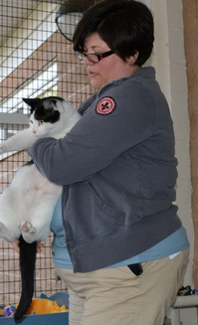
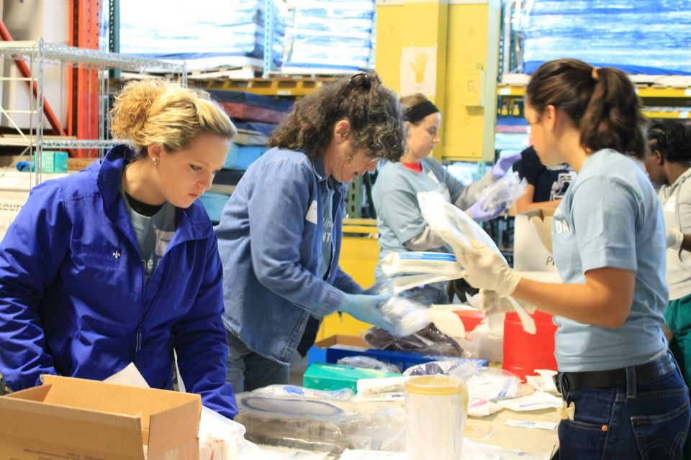
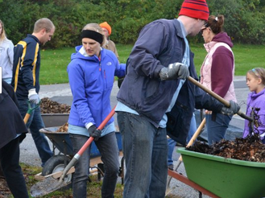
Do extracurricular activities matter?
Extracurricular activities related to a student’s field of interest allows students to:
Build their resume.
Meet potential mentors and network.
Find out if the career is for them.
Apply classroom knowledge.
Hobbies unrelated to field of study can also be valuable.
Notes:
Opportunities abound – clubs, volunteer work, research, job shadowing, summer camps and enrichment activities. Opportunities will increase with the push to get students interested in STEM. Encourage students to take advantage – write letters.

Slide 6
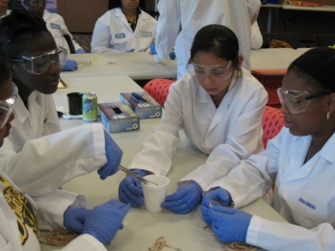
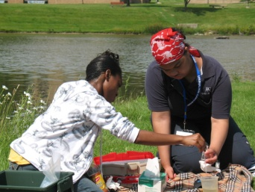
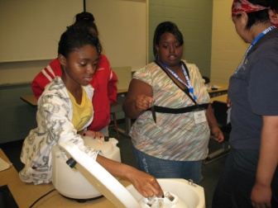
What general skills will students need?
Independence
Organizational skills and Time management skills
Study skills, know what kind of learner they are
Ability to connect concepts together
Reading comprehension
Ability to communicate clearly and concisely
Computer skills
Spatial skills
Notes:
Students need to know what they don’t know, so they know what they need to practice/ study.
If the student doesn’t understand the questions, how can they answer it.
In science, word problems are all there are. “If I didn’t give you word problems, then it wouldn’t be chemistry, it would just be math.” Students often answer the wrong question or only answer part of the question.

Slide 7
What specific skills will students need?
Math and science skills:
Read, interpret, or generate graphs, charts, and tables.
Recognize trends and predict what will happen next.
Use simple statistics: mean, average, standard deviation, and R² values.
Algebraic manipulations, solve for x, especially quadratic equation.
Equations involving log and ln and their inverse.
Metric conversions, Unit and Dimensional Analysis
Geometry basics: shapes, angles, visualizing 3D
Notes:
Nobody know what log is anymore except a button on their calculator.
I have to teach students how to use their calculator to find the inverse log of something.
I make them do simple log and inverse log without calculators.
Dimensional analysis is….
In organic chemistry – deal with shapes of molecules, if you can draw a hexagon, you can draw cyclohexane.

Slide 8
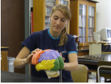
What specific skills will students need?
Computer skills:
Email
Google
Microsoft Word
Superscripts and subscripts
Footnotes and Endnotes
Macros
Insert figures and tables
Microsoft PowerPoint
Insert media
Microsoft Excel
Plot data and use linear regression to generate the equation of a line.
Enter formulas
Auto Fill cells with data
Notes:
Amazed by number of students who’ve never heard of Google Scholar.
Need to be able to type of chemical formulas and math equations properly, also for referencing.
Macros – Turns multiple clicks into one for those time consuming, repetitive things. (temp macro)

Slide 9
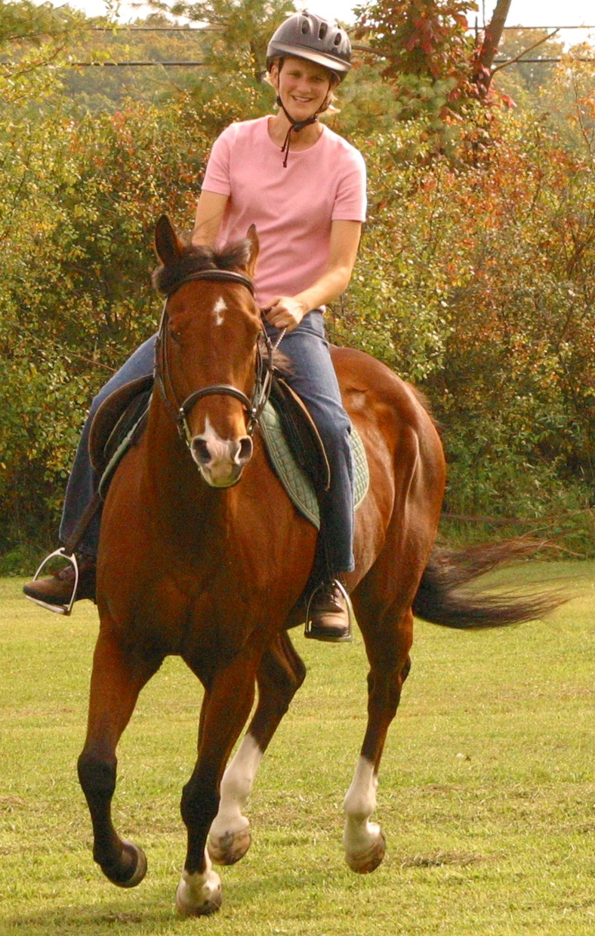
How should students choose a major?
Imagine life in college:
Are the required courses interesting to you?
Do you have or can you acquire the necessary background for the courses?
What are the pros and cons of your possible major?
Will you need to work while attending college?
In what time frame do you expect to be finished?
Resource for Students: Forbes and U.S. News &
World Report Rank Majors and Colleges

Slide 10
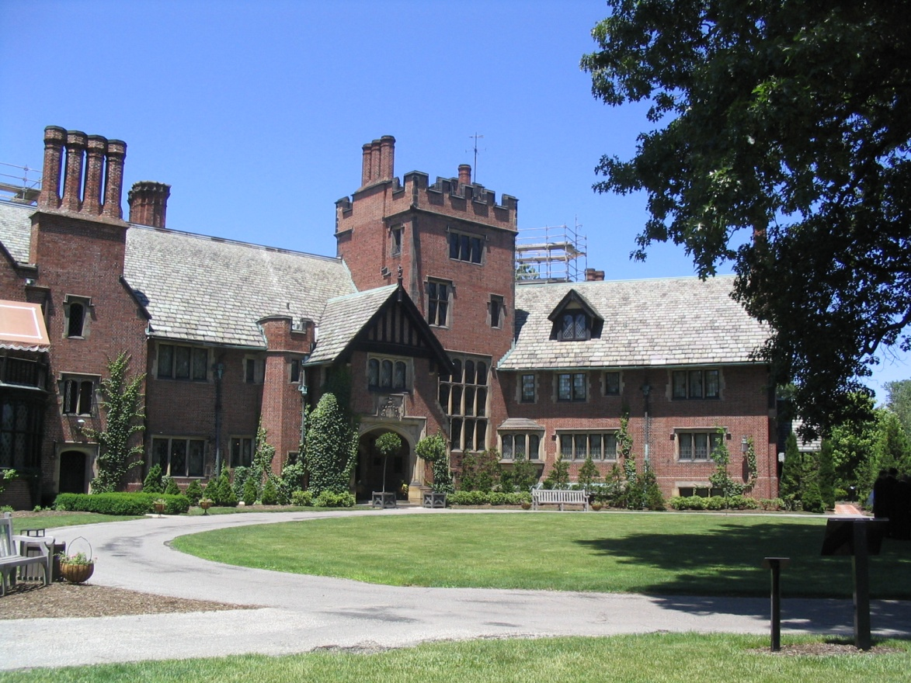
How should students choose a major?
Be realistic about your choice:
How strongly are other people influencing your choice?
How much of a factor is future salary?
How much do you really know about it?
Is it going to be worth the time, effort, and money?

Slide 11
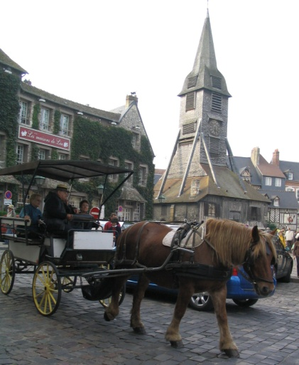
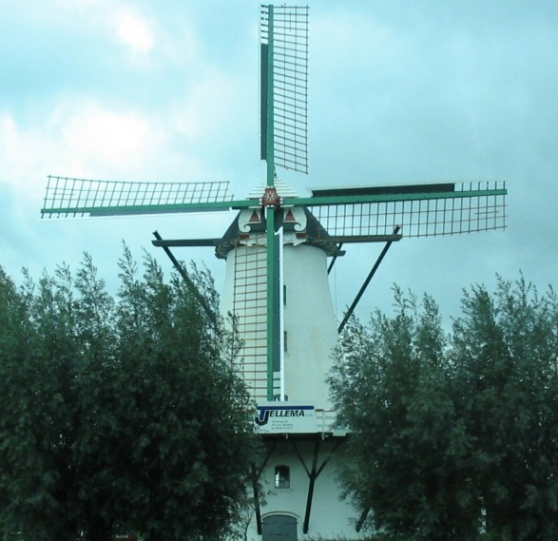
How should students choose a career?
Imagine life after college:
Will you attend graduate or professional school?
Can you achieve your life goals on the salary?
Will you be geographically limited?
Will employers be competing for you or will you be competing for a job?
What will it be like day to day?

Slide 12
How should students choose a career?
Imagine life down the road:
Is having opportunity for advancement important?
Is potential growth in salary important?
Will you be able to balance this career with other goals in your life?
Will this career still stimulate you in 20-30 years?

Slide 13
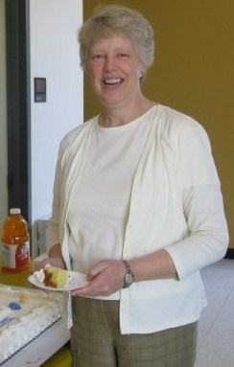
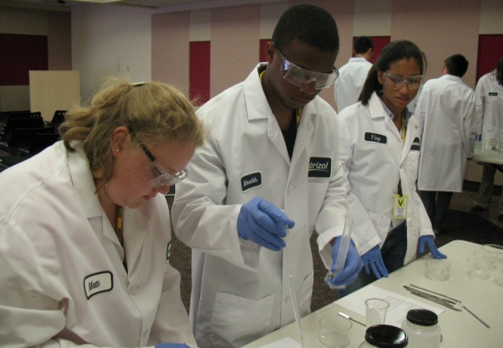
What about mentoring and networking?
The best mentors:
Are good role models
Have common ground with mentee
Are one stage ahead
Help mentee build a network
Are character builders
“Mentoring is a brain to pick,
an ear to listen, and a push in the right direction.”
- John Crosby
Notes:
We all should look to the people ahead of us for mentors and reach back and help pull up those behind us.
Peer mentoring program at Ursuline…

Slide 14
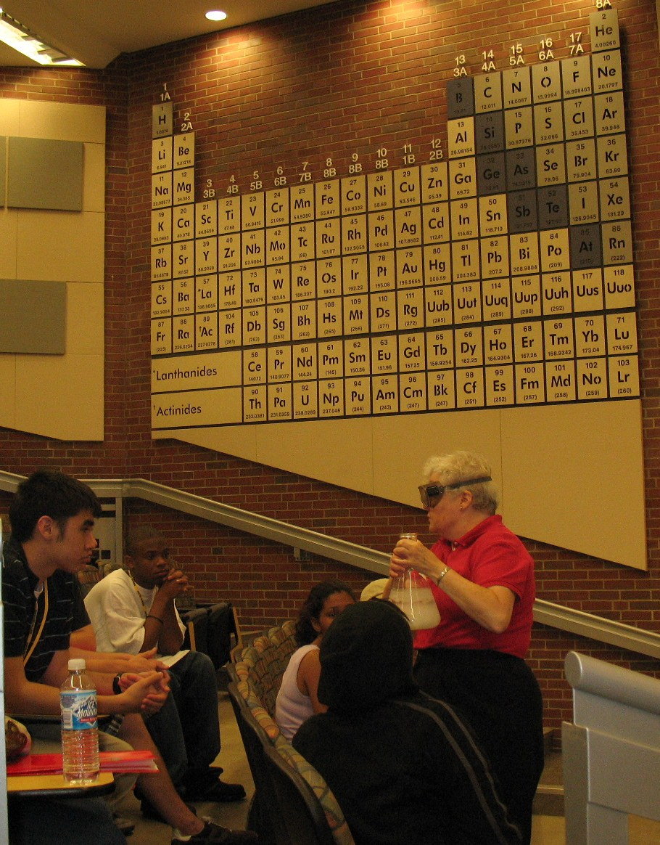
What can STEM college students expect?
What’s a college science lecture course like?
Attendance is neither mandatory, nor recorded, but it is necessary.
Material is covered rapidly and builds on itself, so falling behind is not an option.
Homework problems are usually not graded nor collected, but are also necessary. Sometimes homework is not even assigned.
Reading the textbook is crucial.
Resource for Students :
The Student Doctor Network forums
Notes:
Sometimes recorded lectures are posted on-line.
On-line homework/ practice is common….
Describe CH 108 flipped class and CH 221.
Additional things that have surprised my students:
don’t go over quizzes/ exams in class
don’t just give extra credit out at the end of semester to bail out failing students
office hours/ availability

Slide 15
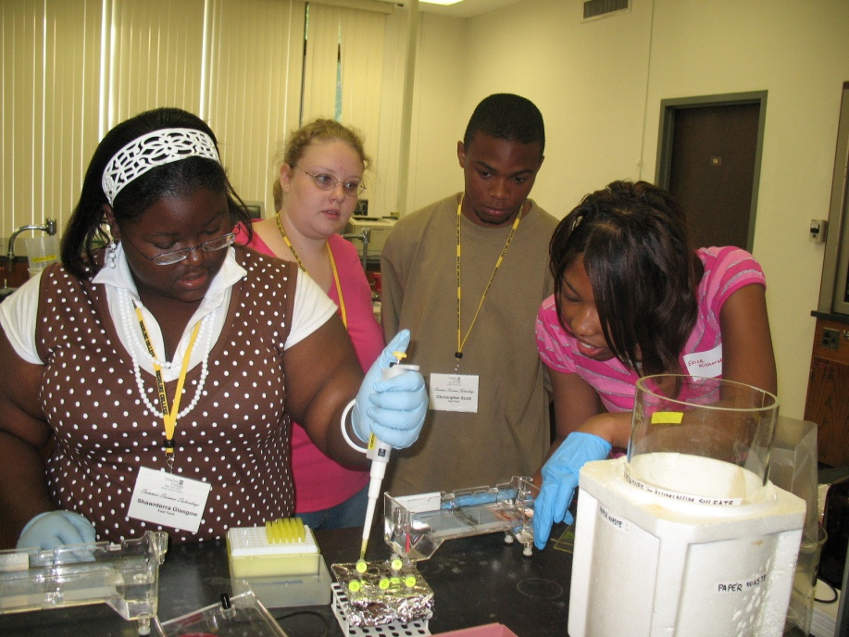
What can STEM college students expect?
What’s a college science lab course like?
Attendance is mandatory
Meet 2-4 hours, 1-2 times a week
Students must prepare ahead for lab, which may include research on the topic.
Student usually work in rotating pairs
Students are required to keep a lab notebook
Post-lab assignments can include formal lab write-up
Students expected to make conclusions based on data.
Notes:
Different from HS in that, once you’re done with the experiment, you can leave, but if you are not prepared or slow, you may have to stay later.
Describe CH 108L and CH 221L

Slide 16
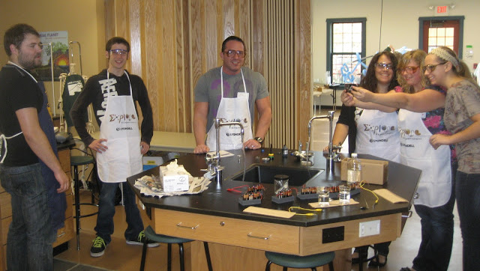
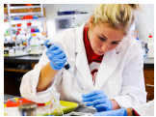
What can STEM college students expect?
How much work will a science course be?
3 hours/ per credit hour/ week is common, but varies.
Lab courses are usually almost as time consuming as lecture.
Time needs to be spent on the course everyday.
Full-time students should approach college as a full-time job.
STEM majors typically contain more total credit hours than non-STEM majors.
Notes:
Science is learned best in small chunks, not all at once right before the exam.
Students in STEM majors will either have to take many credit hours in a semester or take more than 4 years (16-19/ semester is normal).

Slide 17
Thank You!
Sarah Preston
spreston@ursuline.edu
440.684.6073
Any Questions???

