Slide 1
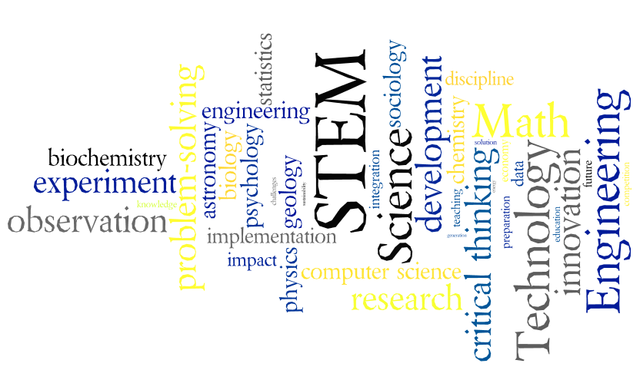
STEM Education:
Why and how to encourage students to choose STEM fields

Slide 2
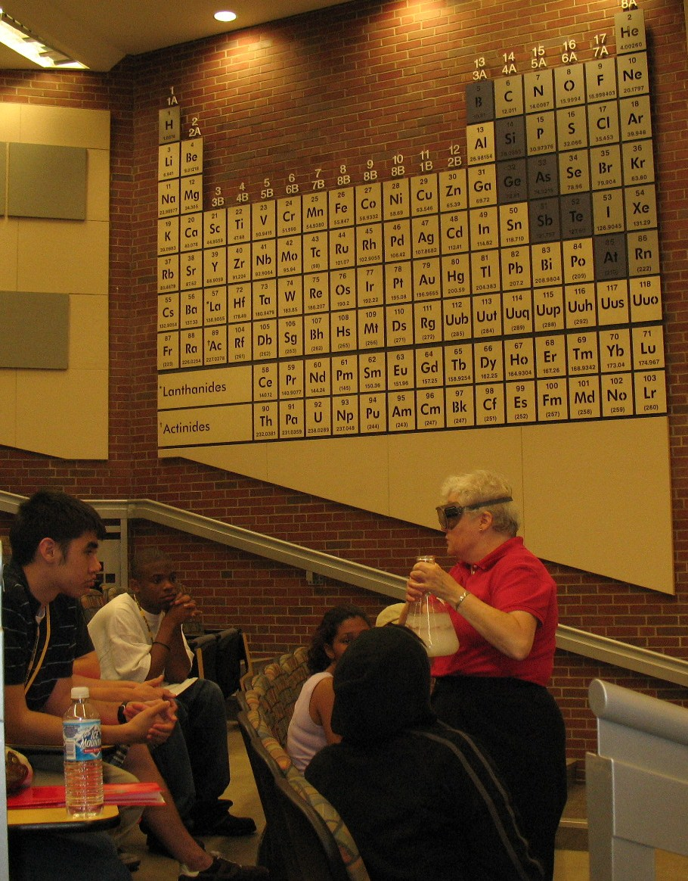
What is STEM?
STEM fields include:
Physics and Nuclear Physics
Chemistry and Biochemistry
Math, Statistics, and Economics
Actuarial Science
Computer Science and Robotics
Psychology and Sociology
Astronomy and Geology
Biology
Computer, Electrical, Mechanical, Industrial, Civil, Aerospace, and Chemical Engineering
STEM:
Science
Technology
Engineering
Math

Slide 3

Outcomes of STEM Education
Besides specific content knowledge and technical ability, a STEM education equips students with:
These skills are highly desired by employees and essential for 21st-century citizens to make informed decisions.
Critical thinking ability
Proficiency at solving non-routine problems
Understanding of how things work
Innovation and creativity
Complex communication skills
Adaptability
Social and cultural competence

Slide 4

Features of STEM Education
STEM learning focuses on activities
that keep students actively engaged.
Essential skills are acquired though:
Collaborative learning
Inquiry-based learning
Problem-based homework
Laboratory investigations
Presentations and posters
Writing assignments
Lab reports
Research projects

Slide 5
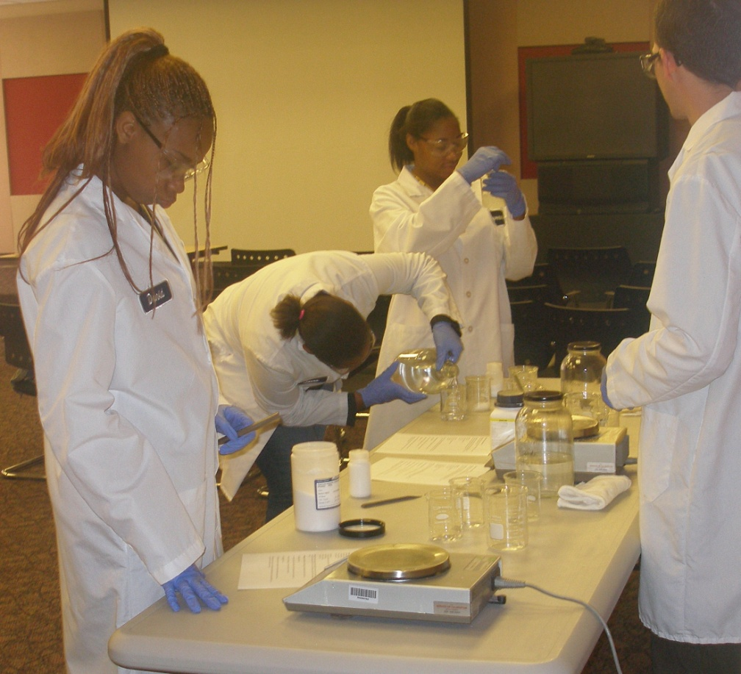
Why is STEM Education Important?
Currently a lack of qualified candidates for jobs that require a STEM education.
US needs STEM-related talent to compete globally.
Citizens need to be STEM literate to better make personal and political decisions.
World’s current energy and environmental problems will be solved through innovation and technology.
Notes:
STEM education is important to companies and employers because……yes, even with the current rate of unemployment, there are employers who can’t fill their position. More on this coming up….
STEM education is important to the future of this country and is critical to maintain the social, economic, and national security that comes with pre-eminence in STEM fields.
STEM education should be important to the average citizen…Organic food debates on Facebook, Chemophobia, 40 gallons of “hexagon” story
STEM education is important to the fate of this planet….in early 1900’s Fritz Haber – revolutionized agriculture nitrogen → ammonia, then invented chemical warfare

Slide 6
State of STEM Education in US
World Economic Forum ranks the US 48th in quality of math and science education.
Of US public school students in 5-8th grade, 69% are taught math and 93% are taught physical sciences by teachers without degrees or certificates in these areas.
The average American K-12 student spends 4 h/ day in front of a TV.
78% of HS grads didn’t meet readiness benchmark levels for one or more entry-level college courses in math, science, reading, and English (ACT College Readiness Report 2008).
In 2000, more foreign students than US students studying physical sciences and engineering in US graduate schools.
From “Rising Above The Gathering Storm, Revisited”
p. 6-15

Slide 7
STEM Education: Why should we care?
Because that’s where America’s future lies!
A few frightening factoids about the US:
2009 rankings of the Information Technology and Innovation Foundation: US in 6th for global innovation-based competitiveness, but ranked 40th in the rate of change over the past decade.
16 energy companies have larger reserves than the largest US company.
US consumers spend more on potato chips than the government devotes to energy R&D.
51% of US patents were awarded to non-US companies and only 4 of top 10 companies receiving patents were from US.
From “Rising Above The Gathering Storm, Revisited”
p. 6-15

Slide 8
STEM Education: Why should we care?
Because that’s where America’s future lies!
A few frightening factoids about China:
China has replaced the US as the world’s number one high-technology exporter.
China has a $196 billion positive trace balance. The US’ balance is negative $379 billion.
Roughly half of American’s outstanding public debt is now foreign-owned – with China the largest holder.
In 2007 China became 2nd only to the US in the estimated number of people engaged in scientific and engineering research and development.
From “Rising Above The Gathering Storm, Revisited”
p. 6-15

Slide 9
STEM Education: Why should we care?
Because that’s where the jobs are!
Workers with STEM-related skills are needed:
"Too many students and adults are training for jobs in which labor surpluses exist and demand is low, while high-demand jobs, particularly those in STEM fields, go unfilled.”
- William Swanson, Chairman and CEO of Raytheon, Massachusetts' STEM Summit
Notes:
For every unemployed STEM worker, there are 2 unfilled positions.

Slide 11
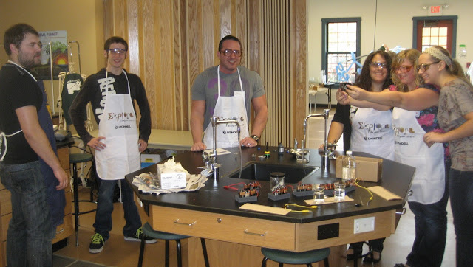
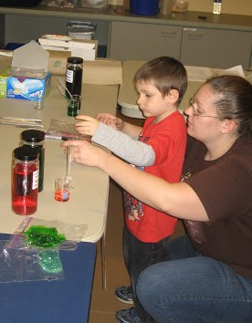
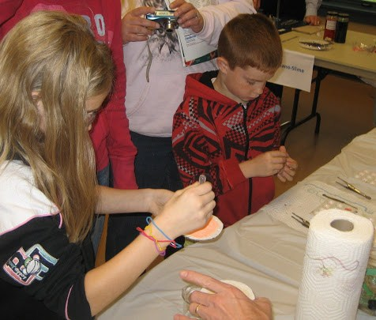
How many STEM workers are needed?
How many would we have at current rate?
  3 million STEM graduates in next decade
How many more are needed to maintain historical
pre-eminence in STEM fields?
  1 million more in next 10 years! A 33% increase.
Notes:
and gain the social, economic, and national-security benefits that come with such pre-eminence
http://chronicle.com/article/Encouraging-STEM-Students-Is/132425/

Slide 12
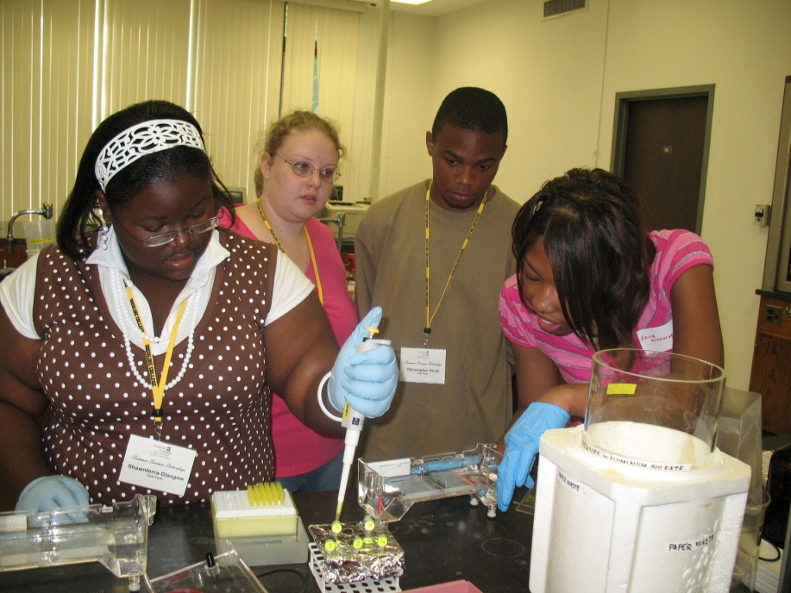
What fields are in high demand?
The 15 Most Valuable College Majors
Ranked by median starting pay, median mid-career pay, growth in salary, and wealth of job opportunities:
Biomedical Engineering
Biochemistry
Computer Science
Software Engineering
Environmental Engineering
Civil Engineering
Notes:
http://www.forbes.com/sites/jennagoudreau/2012/05/15/best-top-most-valuable-college-majors-degrees/

Slide 13
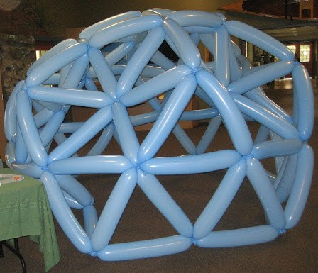
What fields are in high demand?
The 15 Most Valuable College Majors
Geology
Management Information Systems
Petroleum Engineering
Applied Mathematics
Mathematics
Construction Management
Finance
Physics
Statistics

Slide 14
STEM Education: Why should we care?
Because that’s where the money is!
STEM-related skills are not just a source of jobs, they are a source of high-paying jobs:
65% with Bachelors‘ in STEM fields earn more than Master's degrees in non-STEM occupations.
47% with Bachelor's degrees in STEM occupations earn more than PhDs in non-STEM occupations

Slide 15
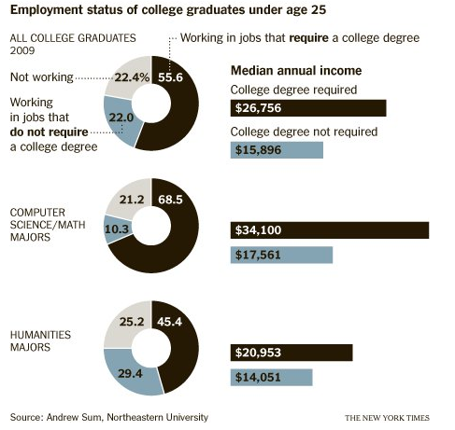
STEM Education: Why should we care?
For computer science/ math graduates compared to the national average:
Overall employment rate is higher.
Median annual income is higher.
Lower percentage working jobs that do not require a college degree.

Slide 16
STEM Education: Why should we care?
Because that’s where the money is!
Example Starting Salaries
Field | Average Starting Salary
Chemical Engineering | $64,500
Applied Mathematics | $52,600
Chemistry | $42,000
Biology | $37,900
English | $35,000

Slide 17
Median Earning by Major Group
Notes:
Top 2 groups for employees with bachelor’s degree:
Engineering $75,000.
Computers and Math $70,000
Top 3 groups for employees with a graduate degree:
Engineering $99,000
Physical sciences $90,000 Yay! Chemistry!
Computers and mathematics $89,000

Slide 18



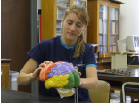

Why are students hesitant to choose STEM majors?
60% of young adults named at least one factor that kept them from pursuing further education or work in STEM fields.
Reasons included:
Don’t know much about the fields (34%)
Too challenging (33%)
Not well-prepared to seek further education in these areas (28%)
Study by the Lemselson-MIT Invention Index
Notes:
http://www.usnews.com/opinion/articles/2012/06/15/stem-education-is-the-key-to-the-uss-economic-future

Slide 19

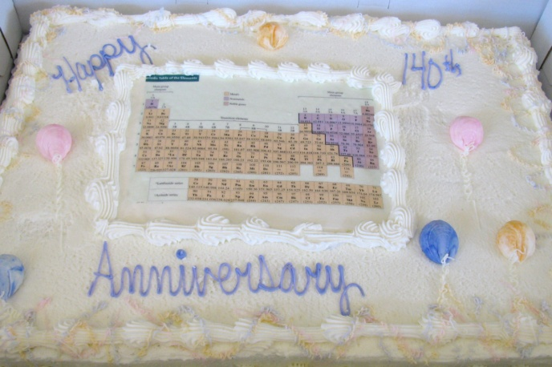
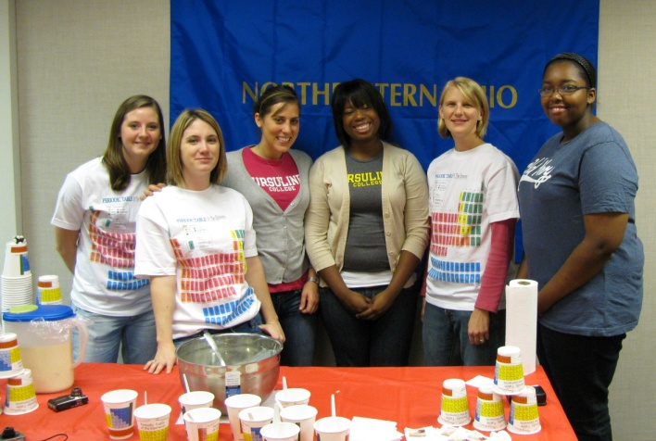

What can STEM workers do about the shortage of STEM talent?
Those working in STEM fields:
Share your passion for the field
Participate in community outreach and public education
Serve as mentors
Collaborate with schools
Encourage government to support STEM education

Slide 20







What can educators do about the shortage of STEM talent?
Need to make students aware of STEM careers :
Invite STEM speakers
Connect students with mentors
Encourage students to participate in enrichment activities
Notes:
Write letters of recommendation for programs…

Slide 21
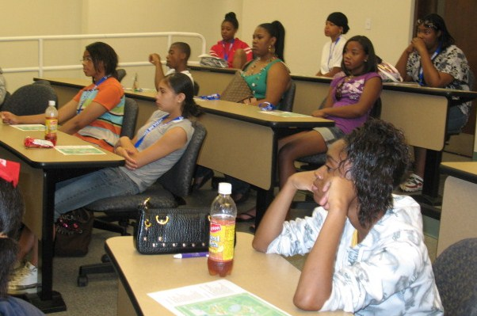
What can educators do about the shortage of STEM talent?
Reduce attrition rates in college:
60% of students who begin as STEM majors end up switching to non-STEM majors.
Why do students drop out of STEM majors?
Uninspiring intro courses
Unwelcoming academic culture
  Esp. for women and minorities who are 70% of students, but only 45% of STEM
Difficulty with required math because of inadequate preparations.
Notes:
If we could cut attrition rate down to 50%, there would be an increase of 0.75 mil STEM graduates in the next 10 years. 75% of the additional 1 million needed.

Slide 22

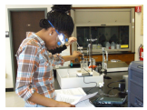


Women in STEM: Is it still an issue?
Only 25% of total STEM workers are female
Demographics vary with field and level:
Women earn 50% or greater of BS in chemistry and math
Physics is a different story, in 2007, 5% of full professors, 16% of doctoral candidates, and 22% of undergraduates majors were women.
Women have only 14% of engineering jobs in the US and currently make up only 15% of all engineering students.
General trend is equal representation in high school and attrition occurs at each level.
Notes:
http://www.news.cornell.edu/stories/April07/women.physics.MR.html
http://www.usnews.com/education/high-schools/articles/2012/05/31/college-mentors-key-to-prospective-female-stem-majors
http://www.aauw.org/learn/research/upload/whysofew.pdf
Computer science majors also 20% women.

Slide 23
Women in STEM: Is it still an issue?
“Thirty years ago there were 13 boys for every girl who
scored above 700 on the SAT math exam at age 13; today that ratio has shrunk to about 3:1. This increase in the number of girls identified as ‘mathematically gifted’ suggests that education can and does make a difference at the highest levels of mathematical achievement.”
“Why So Few”
AAUW report
Why are there so few women in STEM?
Biological gender differences?
Social factors
Negative stereotypes
Environmental factors
Unintentional bias
Institutional structures
Notes:
Because the culture believes women can’t or don’t want to do math and science.
Because we’ve internalized that bias.
Because teens thinks science isn’t cool or is for nerds.
More difficult because family responsibilities…
http://www.aauw.org/learn/research/upload/whysofew.pdf

Slide 24
How can we encourage women in STEM?
Provide female mentors and role models, esp. college students for high school students.
Dispel myths and stereotypes.
Emphasize that girls and boys achieve equally well in math and science.
Be aware of our own implicit bias.
  (test your own @ https://implicit.harvard.edu)
Provide spatial skills training.
Check out: For Girls in Science @ forgirlsinscience.org!
Notes:
From Why So Few…
One finding shows that when teachers and
parents tell girls that their intelligence can expand with experience and learning, girls do better on math tests and are more likely to say they want to continue to study math in the future
When test administrators tell students that girls and boys are equally capable in math, the difference in
performance essentially disappears, illustrating that changes in the learning environment can improve girls’ achievement in math.
individuals’ spatial skills consistently improve dramatically in a short time with a simple training course. If girls grow up in an environment that enhances their success in science and math with spatial skills training, they are more likely to develop their skills.

Slide 25
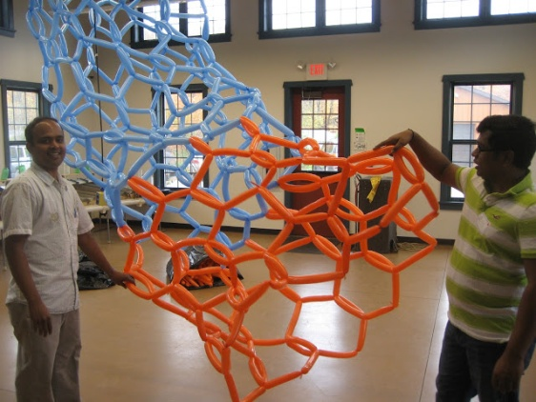

How can we encourage students to choose STEM majors and fields?
Encourage natural interest.
Educate about opportunities.
Erase negative connotations.
Cultivate talent and abilities.
Prepare rigorously in math and science.

Slide 26
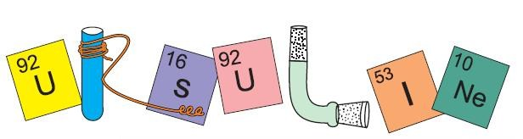
Thank You!
Sarah Preston
spreston@ursuline.edu
440.684.6073
Any Questions???

